Slide 1
Short Course in Linguistics
Intro to Morphology

Slide 2
Topics
Phonetics and Phonology
Morphology
Syntax
Language Change
Identity

Slide 3
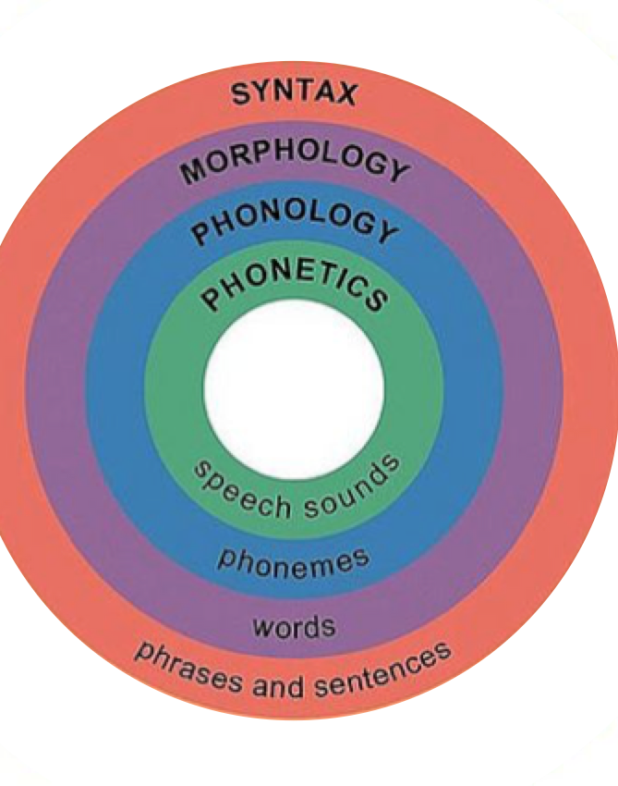
Linguistic hierarchy

Slide 4
Onto today’s topic...

Slide 5
Why do we care about syntax?
If we want to translate we need to know what’s going on in a sentence
If we want to search intelligently, we need to know what to search on
To attempt any information activities, we need syntax
To perform accurate lemmatization, we need syntax (and morphology)

Slide 6
SYNTAX!!
Syntax is where language gets exciting
Phonology and morphology are more abstract concepts
With syntax, we start finding out who did what to whom....
And how we encode that when we speak

Slide 7
Syntax
Syntax is the set of rules, principles and processes that govern the structure of sentences in a language.

Slide 8
Syntax
Syntax is the set of rules, principles and processes that govern the structure of sentences in a language.

Slide 9
Sentences...
Hmmm, you thought words were hard to define?
Try defining a sentence....
We have this definition..
In non-functional linguistics, a sentence is a textual unit consisting of one or more words that are grammatically linked

Slide 10
Did that help?
Well now we’d have to define grammatically linked and we start getting into whole other areas of linguistic disagreement.
So how are we going to define it?
A sentence is a group of words that makes complete sense, contains a main verb, and begins with a capital letter. (OED)
That makes sense for written English but not so much for other languages and I’ve assumed we care about other languages

Slide 11
A compromise...
A sentence is the basic unit of language which expresses a complete thought. It does this by following the grammatical rules of syntax.

Slide 12
What comprises a thought?
For most of my day thoughts consist of either
“huh?”
“um”
These make for uninteresting analysis (although when analysed, they are usually considered thinking words).

Slide 13
What comprises a thought?
Take the English sentence....
The man hit the wall.
This very simple sentence demonstrates a range of different syntactic features of English
‘The man’ is what is referred to as the subject of the verb.
‘the wall’ is referred to as the object of a verb
‘hit’ is just the verb

Slide 14

Constituent Order
English has very strict constituent order
Subject (S) -> Verb (V) – Object (O)
Sometimes we just have an SV sentence (I slept).
Sometimes we just have V sentences (Run!!) which are not strictly just V because the subject is implied

Slide 15
Constituent Order
All types of constituent order are attested in the world’s langauges
SVO – English
SOV – Japanese
OVS – Tuvaluan
VSO – Maori, Gaelic
VOS – Nias, Malagasy
OSV – Tobati
No fixed constituent order – Acehnese, Minangkabau, Greek

Slide 16
Constituent Order
So different orders means that we can’t easily take models from one language and re-use them for another
And it gets more complicated when we look at word classes and the ways in which they can be put together
And when we add in different world views and ways of capturing meaning, ambiguity and we add even more complexity

Slide 17
Parts of speech
In English, we have a sense for parts of speech
Nouns
Verbs
Adjectives
Determiners
Prepositions
Adverbs

Slide 18
Parts of speech
But other languages have different sets of these
သူတူနှစ်ချောင်းရှိတယ် Thu tu hna chaung shi de He-chopstick-two-[classifier for long and thin items]-have-[particle indicating present tense]. He has two chopsticks. (Burmese)
Notes:
Shows up a few problems, new parts of speech, a classifier and a particle that indicates tense AND the text doesn’t actually have any breaks to be able to identify which bits are what.........

Slide 19
Parts of Speech
Linguists spend a lot of time determining word classes and syntactic rules
Word classes are determined based on their formal and functional properties
What linguists do actually feels a lot like statistical analysis in a lot of cases
i.e take the most common structure and establish rules
Recursively determine the rest of the rules with ever decreasing amounts of data
Keep a set of ‘weights’ in your head and describe in a grammar

Slide 20
Syntactic Rules
Taking an English example...
John likes Mary
N V N
So we can label parts of speech, but it doesn’t really help us with parsing the sentence

Slide 21
Syntactic Rules
We usually parse sentences as trees.
Thinking back to our word order for English, we know we had SVO word order
So we can draw a very simple tree to represent our sentence
S
S V O

Slide 22
Syntactic Rules
But we can go a step further than that and we can substitute the nouns in at the terminal nodes
S
N V N

Slide 23
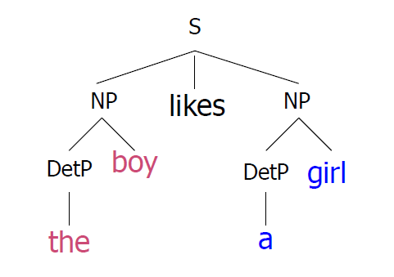
Syntactic rules
Unless you’re John or Mary, this sentence is pretty boring, so we can start thinking about how we might represent more complex things
The boy likes the girl

Slide 24
Syntactic Rules
But language is so much more complicated than that and we can do things like:
The boy with the glasses who lives down the street in the big blue house likes the girl from school who has dark hair and is always reading Tolstoy.
And we expect to be able to extract the relevant information from this type of data across multiple languages in noisy data

Slide 25
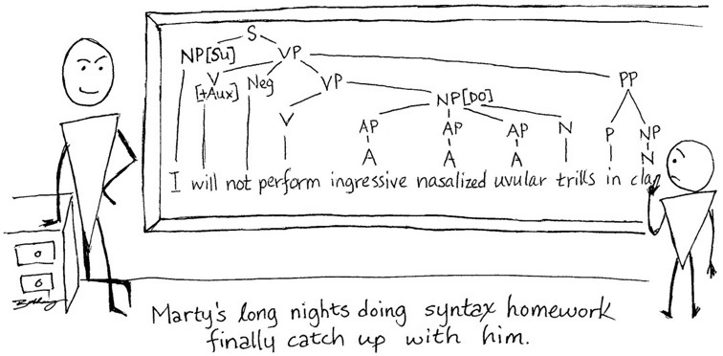
A terrible linguistics joke

Slide 26
Ambiguity
Ambiguity is the destroyer of all things NLP and we come across our fair share in syntactic analysis
‘ Time flies like an arrow’
There are three ways to read this sentence
How do we resolve this type of problem?
If it were spoken, we can differentiate it with emphasis and tone, but when it’s written???

Slide 27
Ambiguity
The type of ambiguity we came across there was structural ambiguity and without context, we can’t resolve it
But there is also part of speech ambiguity there as well – was ‘flies’ a noun or a verb?
What about ‘time’?

Slide 28

Ambiguity
There are other types of ambiguity
Constructional ambiguity

Slide 29
Ambiguity
We’ll leave ambiguity here, but we need to keep it in mind, our NLP approaches must be sufficient to overcome it – either through statistics, semantic knowledge or context
We should also bear in mind our example of Burmese text from earlier
သူတူနှစ်ချောင်းရှိတယ်
They’re important issues to ruminate on as we think about undertaking some syntactic NLP

Slide 30
The problem
We have a piece of text, it’s in a language you don’t know and you want to find out what it’s about and whether or not someone should care about it.
‘Krisis akomodasi telah mendorong University of Tasmania (UTAS) membeli sebuah hotel bintang tiga di Kota Hobart untuk membantu menyediakan tempat tinggal yang terjangkau bagi mahasiswa.’
How should we approach the problem?

Slide 31
Solutions
Named Entity Recognition
Syntactic parsing
Information extraction
Sentiment analysis
All of these require some pre-processing in the form of POS tagging (and some lemmatization and stemming wouldn’t go astray either)

Slide 32
POS tagging
If our problem were in English, we would have an easier task
There are a lot of pre-tagged datasets for English like the PennTreeBank
These tagsets allow for the quick and easy training of models for any number of approaches
But our dataset is not in English – let’s build that tagset for our target language (hang on a minute, that takes some linguistics knowledge and time and money!!)

Slide 33
POS Tagging
So we create or find a atgset, now we want to use it in anger
There are currently two choices for mainstream POS tagging
Hidden Markov Model (HMM) implemented using the Viterbi algoritm
Maximum Entropy Markov Models

Slide 34
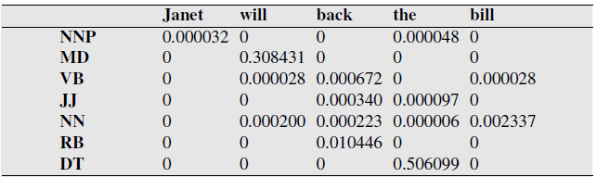
POS Tagging
The sentence ‘Janet will back the bill’ has several layers of ambiguity
If we use a HMM trained on the Wall Street Journal corpus to analyse the sentence, we get the following set of probabilities

Slide 35
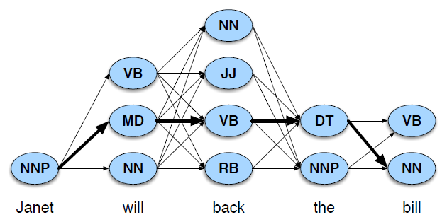
Which is probably best represented as a lattice

Slide 36
POS Tagging
So we need to calculate the transitional probabilities from our tagset and then apply one of the two methods to tag our data
Krisis/NN akomodasi/ADJ telah/ADV mendorong/V University/NNP of/PP Tasmania/NNP (UTAS)/ABR membeli/V sebuah/QU hotel/NN bintang/NN tiga/NU di/PP Kota/NNP Hobart/NNP untuk/PP membantu/V menyediakan/V tempa/NN tinggal/NN yang/CONJ terjangkau/V bagi/CONJ mahasiswa/NN.

Slide 37
Named Entity Resolution
So our parsing determined some proper nouns, which is great and lets us pick up some Named Entities
It’s done this using a number of rules, the most important in this case being the shape of the words (they start with a capital letter)
Unknown parts of speech can also be identified using their morphology and a pre-processing step like lemmatisation, which groups words into similarity sets and determines morphology helps with word class determination

Slide 38
Named Entity Recognition
Krisis/NN akomodasi/ADJ telah/ADV mendorong/V [University/NNP of/PP Tasmania/NNP_{org}] (UTAS)/ABR membeli/V sebuah/QU hotel/NN bintang/NN tiga/NU di/PP [Kota Hobart/NNP_{org}] untuk/PP membantu/V menyediakan/V tempat/NN tinggal/NN yang/CONJ terjangkau/V bagi/CONJ mahasiswa/NN.
But we also want to parse the sentence, so we can work out what the topic is and work out whether we care about it or not.
If we wanted to just pull topics out we could use LDA or something similar but we want to do this in a slightly deeper way.....

Slide 39
Lemmatization

Slide 40
Part of Speech (POS) tagging

Slide 41
Named Entity Recognition
Tries to find named entities in text
People, organisations, percentages, time, locations ......

Slide 42
Sentiment Analysis

Slide 43
Next time...
Morpho-syntax
Syntax
A brief look at some more exciting NLP applications...

Slide 44
Questions?
I understand that was pretty long but I would really like some questions and or feedback so that I know that I haven’t put you all to sleep!!

